Slide 1

Mobile Phone API Hacking
By Kaiden Love and Logan Bennett

Slide 2
Goals
Use Android Studio’s Mobile Phone Emulator
Establish a connection via proxy from Burp Suite
Sniff packets using Burp Suite to detect vulnerabilities in API
Machine-in-the-Middle

Slide 3
Functionality

Slide 4
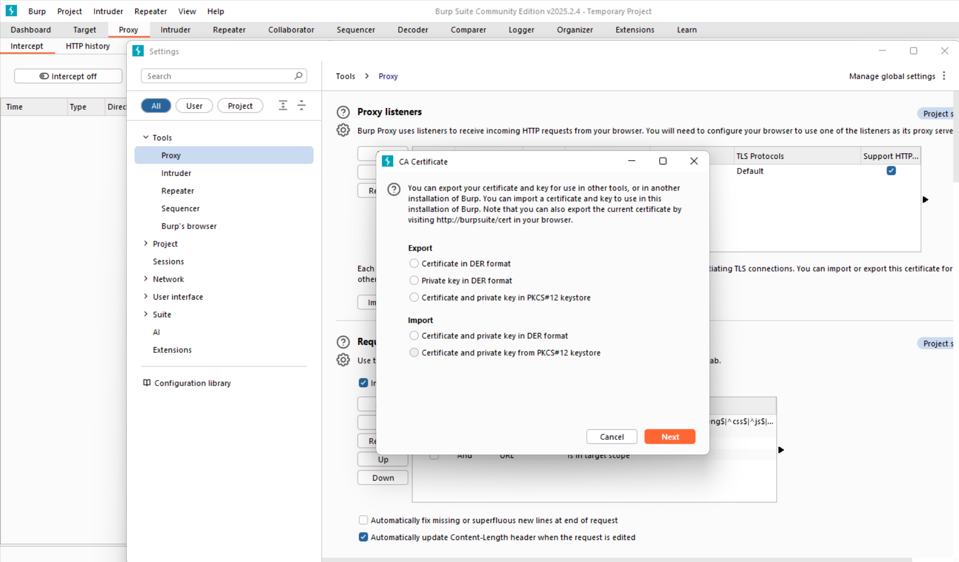
Functionality

Slide 5
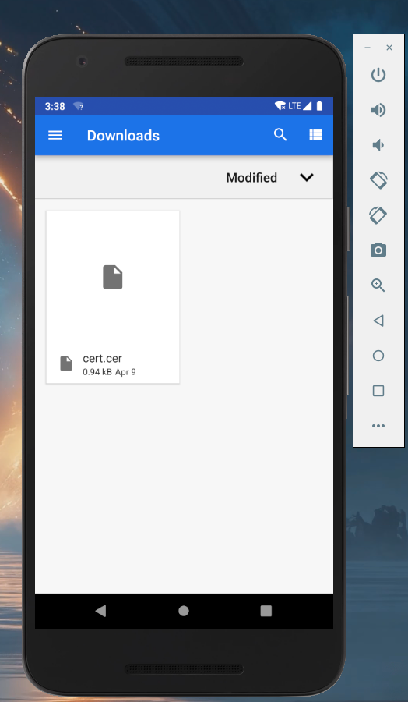
Functionality

Slide 6
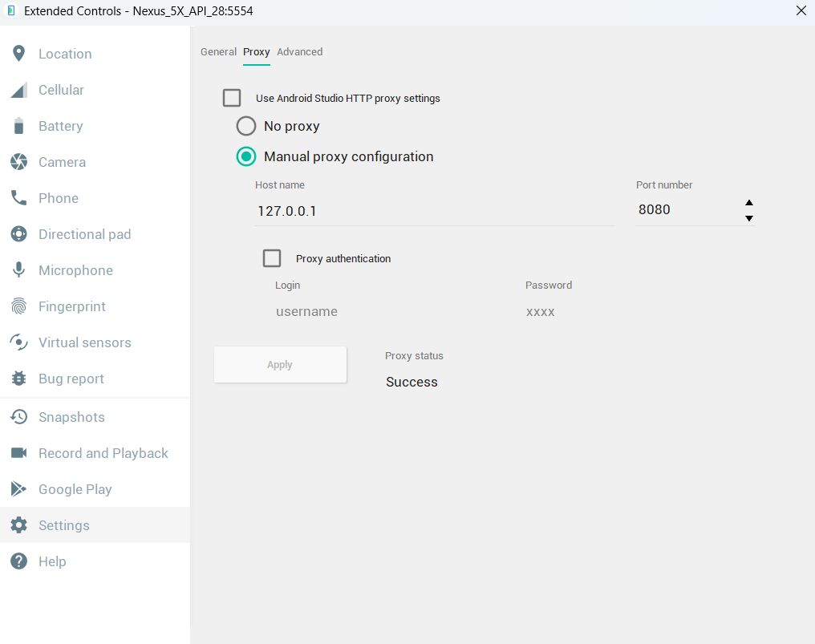
Functionality

Slide 7
Demonstration

Slide 8
Certificate Pinning Bypass

Slide 9
Takeaways
Proxy
Burp Suite
Android Emulator
API Vulnerabilities

